Slide 1
Lesson 3 – Homework review

Slide 2


Slide 3
Invite all reviewers
olexandr.kucher
y.brahinets
Vrudas
InnaBakum
mudrenko.vlad
michaelsav4enko

Slide 4
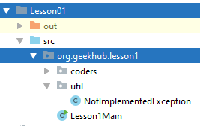
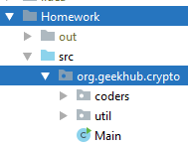
Merge prod

Slide 5
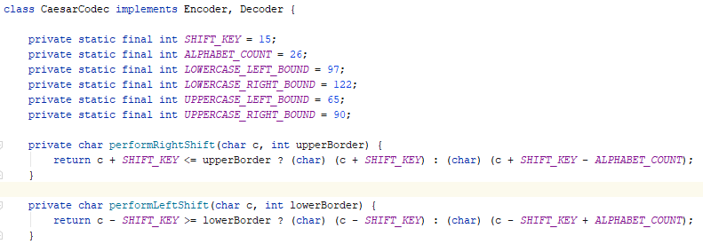
Craft less coupled code (ASCII-independent)

Slide 6
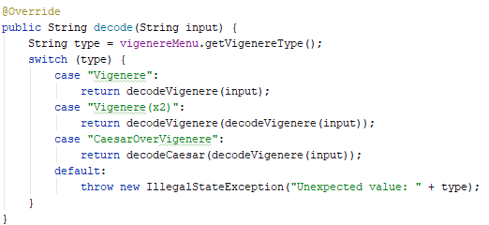
Craft less coupled code. Input-independent

Slide 7
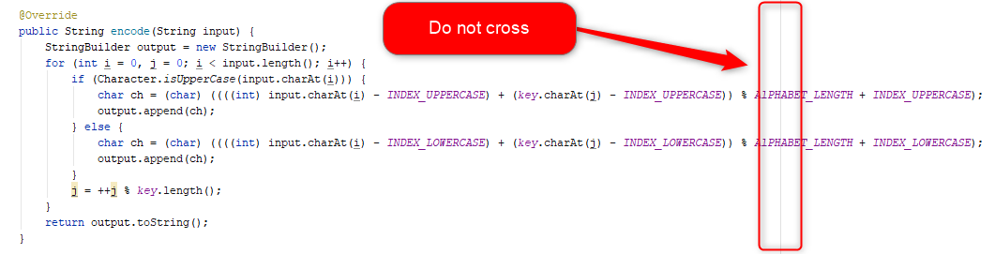
Decompose

Slide 8
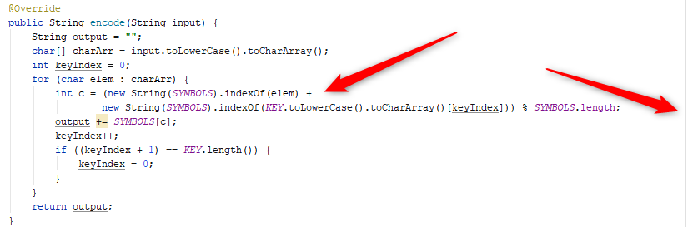
Decompose

Slide 9
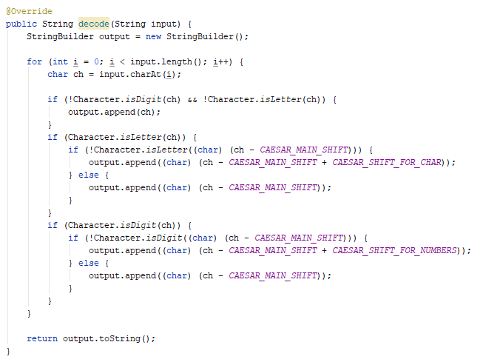
Decompose

Slide 10
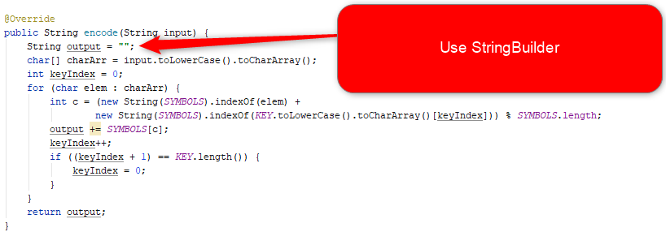
Use effective data structures

Slide 11
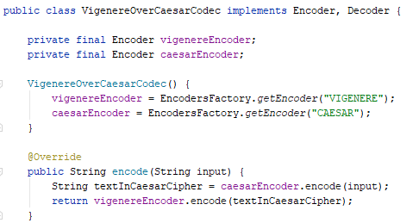
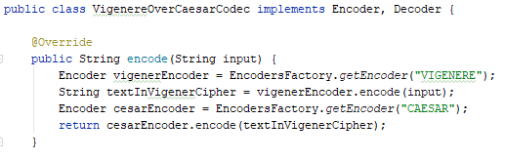
Optimize

Slide 12
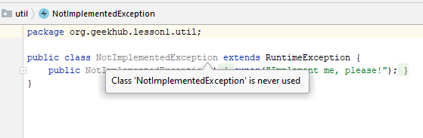
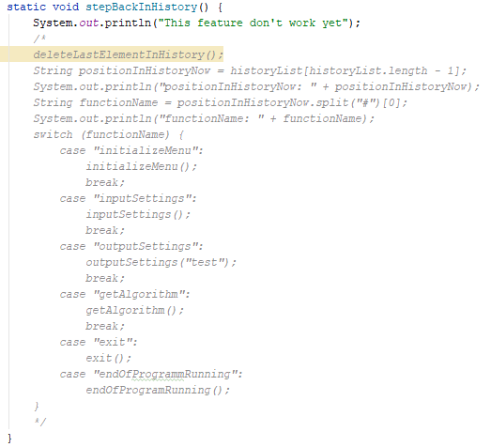
Remove unused code

Slide 13
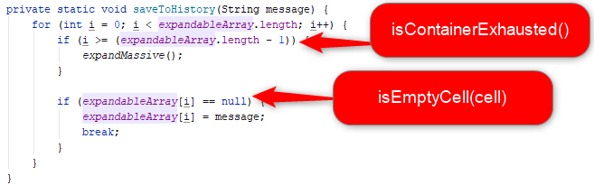
Extract constants and methods

Slide 14
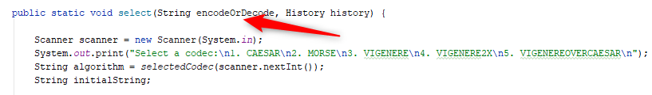
Follow Single Responsibility

Slide 15
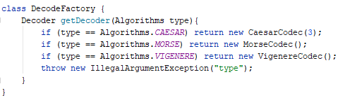
Use braces

Slide 16
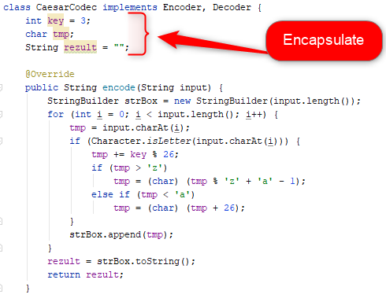
Use the least needed access scope

Slide 17

Craft code open for extension

Slide 18
Apply recommendations from personal feedbacks

